Slide 1
Clustering Solar Energy Production Zones
BORSE JATIN D.

Slide 2
Agenda
INTRODUCTION
DATA PREPROCESSING
EXPLORATORY DATA ANALYSIS (EDA)
MODEL BUILDING(K-MEANS CLUSTERING ALGORITHM)
CONCLUSION

Slide 3
INTRODUCTION
→Project Overview:
This project focuses on clustering solar energy production zones.
By analyzing the data, we will group geographical areas based on their energy production.
This process will help identify regions with high and low solar energy production.
→Why is This Important?
Strategic Targeting – Identify high-potential areas to optimize sales and marketing strategies. Improved Project Feasibility – Enhance project planning by leveraging historical production data. Data-Driven Decision Making – Gain insights into solar resource variability to make informed business decisions.
→ Key Objectives:
Clustering Algorithm Implementation: Categorize geographical areas based on their total solar energy production.
Interactive Map Visualization: Display identified energy production zones on a map. Project Report: Document methodology, findings, and recommendations for future projects.

Slide 4
data preprocessing
→ Loading Required Libraries:
Imported essential libraries: pandas, numpy, matplotlib, seaborn, sklearn.preprocessing, and
sklearn.cluster.
Used warnings.filterwarnings("ignore") to suppress warnings.
→ Loading Dataset:
Dataset Used: "Statewide Solar Projects.csv"
Data loaded into a Pandas DataFrame (df = pd.read_csv("Statewide Solar Projects.csv")).
→Initial Data Analysis:
Displayed first few rows (df.head()).
Checked dataset shape (df.shape).
Listed dataset columns (df.columns).
→ Data Cleaning & Preprocessing Steps:
Handling Missing Values: Checked for null values and removed/filled them appropriately.
Feature Selection: Selected relevant columns for clustering analysis.
Scaling Data: Used MinMaxScaler to normalize numerical features for better clustering performance.

Slide 5
EXPLORATORY DATA ANALYSIS (EDA)
Count Plot
→Plot distribution of City/Town frequencies using a count plot
→Plot distribution of County frequencies using a count plot
2. Scatter plot
** Bivariate Analysis : Understand type of relationship between 2 columns
→ Scatter plot of PV System Size (kWac) vs Estimated Annual PV Energy Production (kWh)
→Scatter plot of PV System Size (kWac) vs Estimated Annual PV Energy Production (kWh)
3. Outliers Detection
→ Boxplots helped find unusual data points (outliers) in the columns: 'Estimated PV System Size (kWdc)', 'PV System Size (kWac)', and 'Estimated Annual PV Energy Production (kWh)’.
→To address outliers, a formula was applied that capped extreme values at 1.5 times the range between the first and third quartiles.
4. Histogram plot
→ The histogram of estimated annual PV energy production (kWh) reveals a distribution of frequencies across different production ranges.
→ The histogram of Estimated PV System Size (kWdc) illustrates the distribution of frequencies across different system size ranges.
5. Density plot
→The graph is highly right-skewed (positively skewed). →Most of the PV system sizes are small (within 0 to 5000 kWac), while a few very large systems (outliers) are also present. This indicates that very large PV systems (e.g., 10,000+ kWac) are rare.

Slide 6
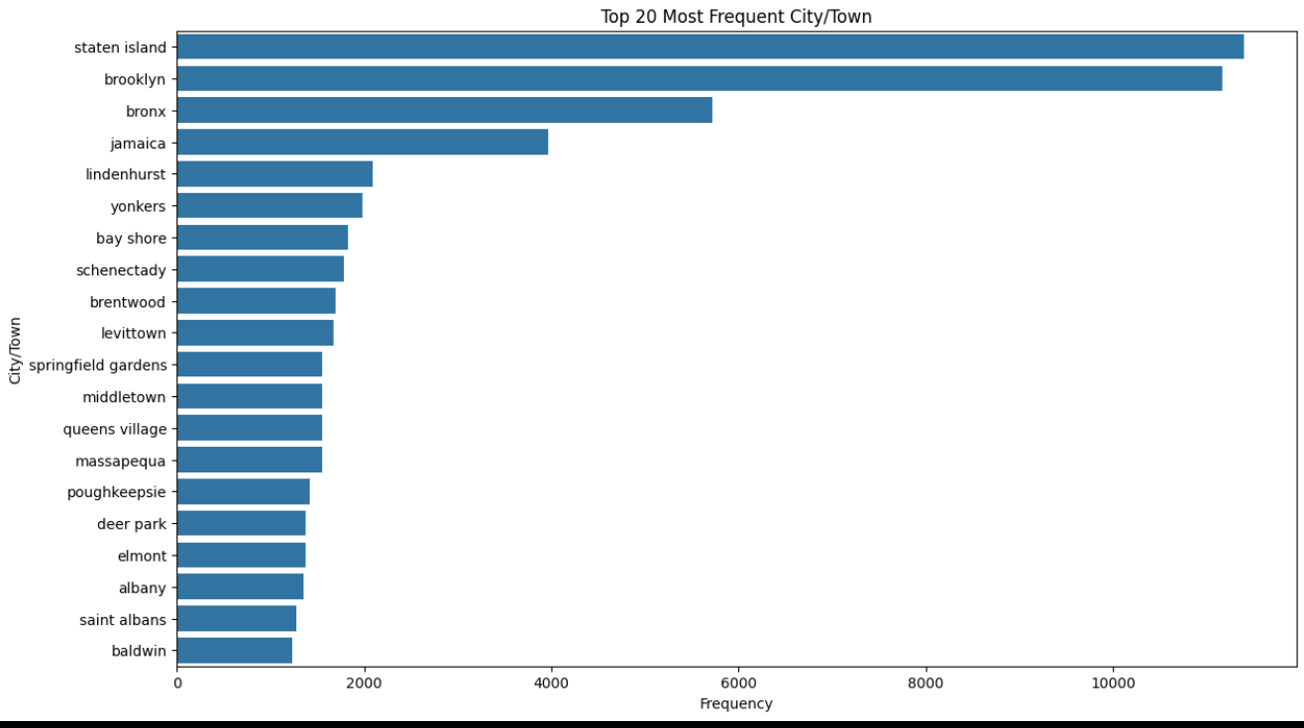
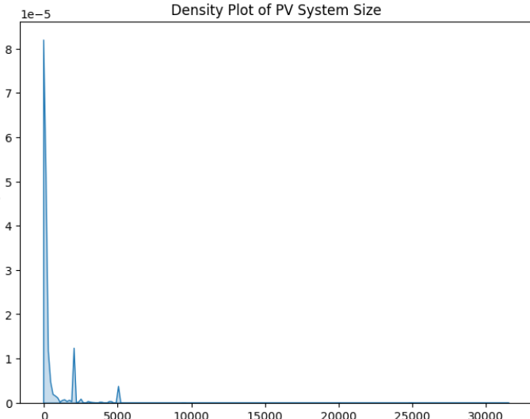
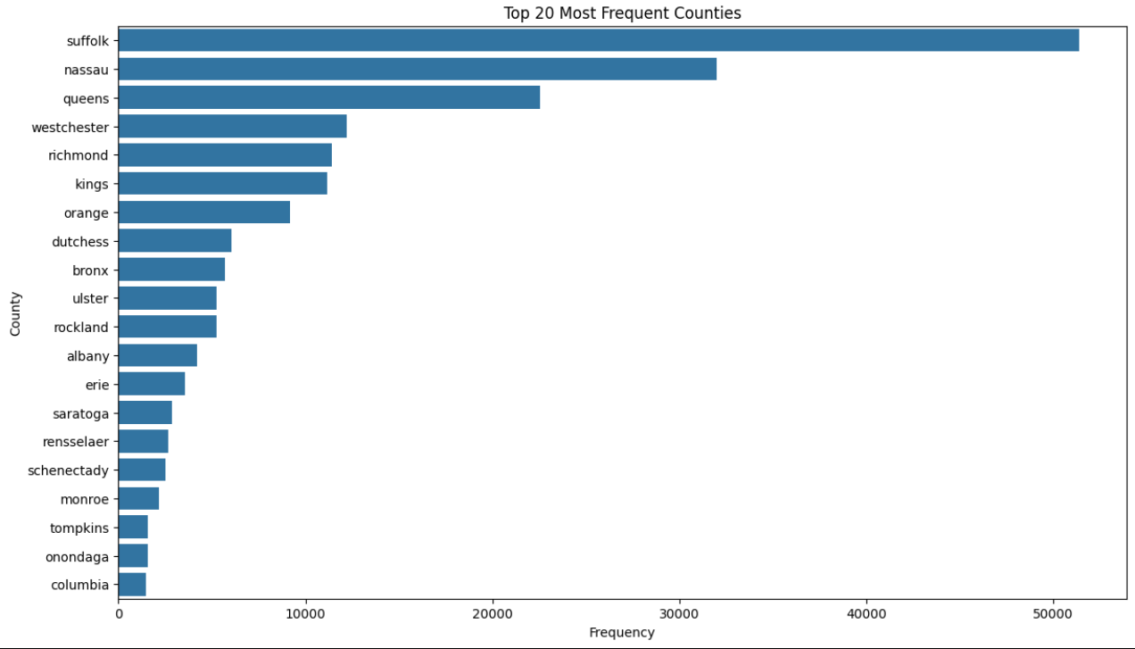
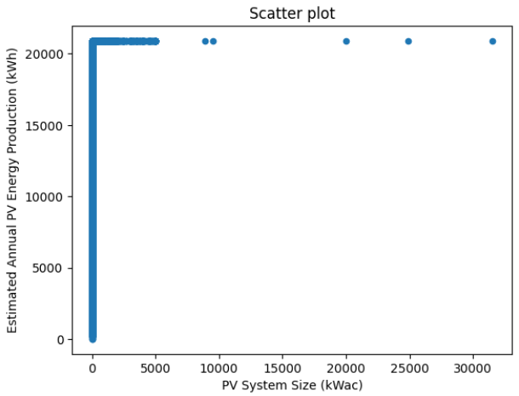
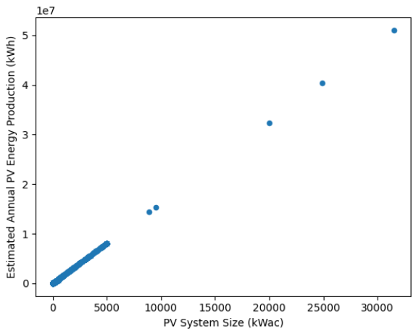
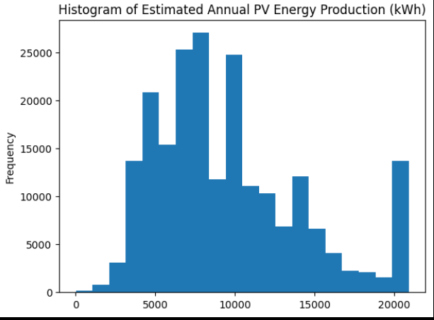
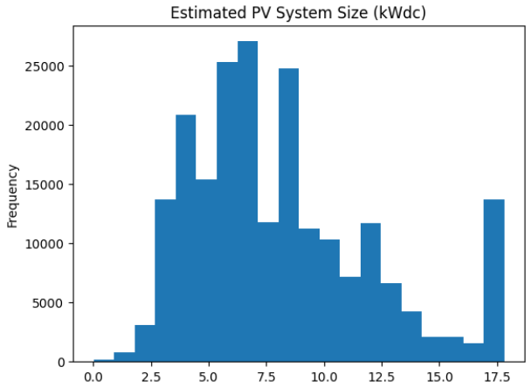
1. (Count Plot)
4. (Density plot)
2.(Scatterplot)
3. (Histogram Plot)

Slide 7
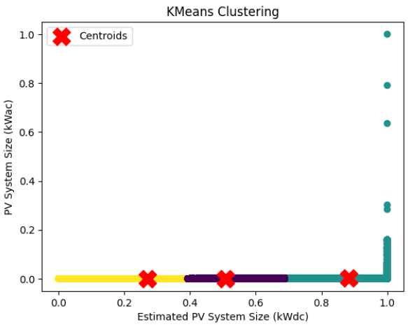
MODEL BUILDING
→Scaling using MinMaxScaler
The MinMaxScaler scales the features to a fixed range between 0 and 1, ensuring that all features are standardized and have a comparable scale.
MinMaxScaler to perform min-max scaling on three numerical features: 'Estimated PV System Size (kWdc)', 'PV System Size (kWac)', and 'Estimated Annual PV Energy Production (kWh)’
→ K-Means Clustering Algorithm
K-means clustering is an unsupervised machine learning algorithm.
It partitions a dataset into K distinct clusters.
The objective is to minimize the within-cluster variance.
Each cluster is represented by its centroid, calculated as the mean of the data points in the cluster.
The algorithm iteratively assigns data points to the nearest centroid and updates the centroids
→ - The linear grouping and placement of centroids suggest that the algorithm effectively separates the data into three clusters based on their feature values.

Slide 8
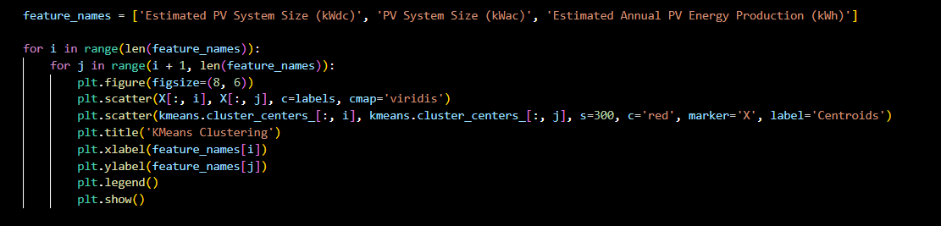
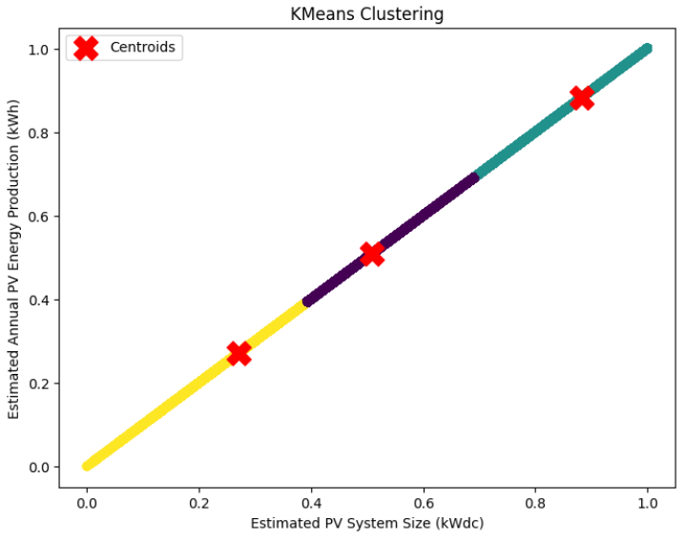
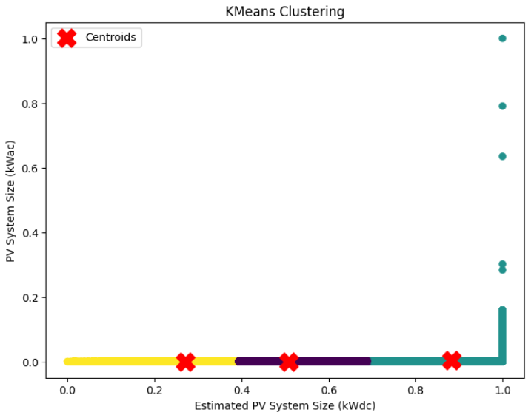
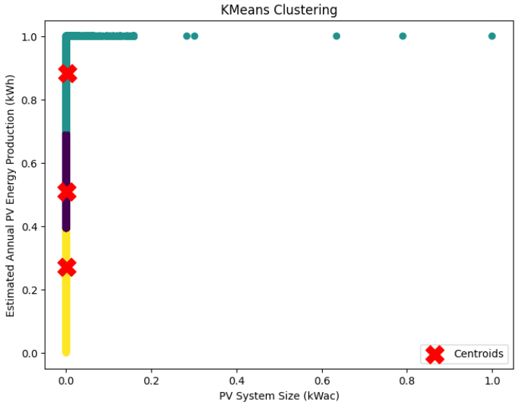

Slide 9
CONCLUSION
The addition of the 'Cluster' and 'Segment' columns enables the DataFrame to categorize each data point into meaningful segments based on the clustering results.
In the higher zone, the estimated annual PV energy production is the highest at 18.67k, followed by 11.32k in the lower zone and 6.12k in the moderate zone.
The average PV system size in the higher zone is the highest among all zones, indicating larger solar installations in this area.
In December, all annual PV energy production occurs, indicating that December is a significant month for solar energy production, potentially due to favorable weather conditions or operational factors.
.

Slide 10
QUESTION

Slide 11
Thank You!

